Slide 1
Programming to an interface
(not an implementation)

Slide 2
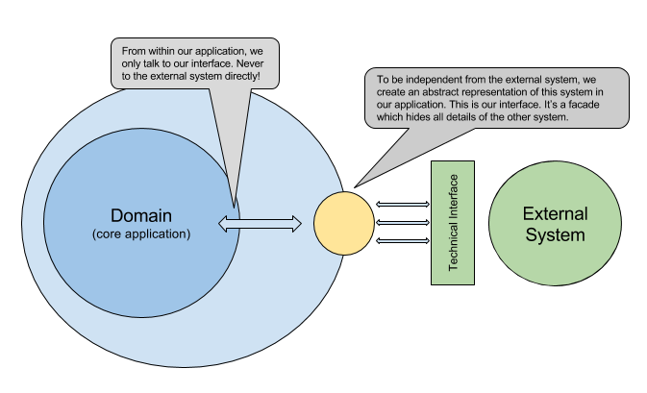
The design principle
Separation between domain and external systems

Slide 3
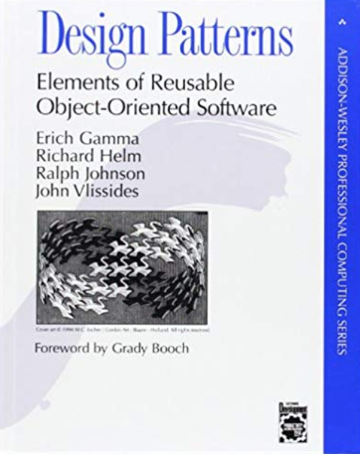
Focus the design on what the code is doing, not how it does it
interface
implementation
From “Design Patterns” (GoF)
The authors claim the following as advantages of interfaces over implementation:
Clients remain unaware of the specific types of objects they use, as long as the objects adhere to the interface that clients expect.
Clients remain unaware of the classes that implement these objects. Clients only know about the abstract class(es) defining the interface.

Slide 4
